Slide 1



PANIMALAR ENGINEERING COLLEGE
DEPARTMENT OF CSE
HUMAN ACTIVITY RECOGNITION USING DEEP LEARNING
PROJECT REVIEW – BATCH C9

Slide 2
TEAM DETAILS
PROJECT GUIDE:
MR. S A K JAINULABUDEEN
TEAM MEMBERS:
KUMARA VAIBHAV C | 211418104133
SHALIN P SUNIL | 211418104242
SHABARI RUBAN M | 211418104241
DOMAIN:
DEEP LEARNING
COLLEGE:
PANIMALAR ENGINEERING COLLEGE

Slide 3
ABSTRACT
Human activity recognition using smartphone sensors like accelerometer is one of the hectic topics of research.
HAR is one of the time series classification problem. In this proposed project, we are not going to use any hardware devices and the proposed system is built using deep learning models have been worked out to get the best final result.
In the same sequence, we can use LRCN (Long-term Recurrent Convolutional Network ) to recognize various activities of humans like standing, walking, swinging, etc.
LRCN model is a type of recurrent neural network capable of learning order dependence in sequence prediction problems. This model is used as this helps in remembering values over arbitrary intervals.

Slide 4
INTRODUCTION
The traditional behaviour model is creating a statistical or analytical model of human behaviour and then fitting a distribution to the model to validate it. The deep learning approach differs significantly from the traditional model.
By studying human behaviour, a deep learning system learns to predict outcomes. Deep learning is the study of human behavioural features and its application to prediction.
Deep learning in commercial applications is a game changer. The capacity to foresee and forecast behaviour, as well as estimate the probability of winning in a game, are valuable economic assets.

Slide 5
EXISTING SYSTEM
The existing system has low accuracy and low efficiency in terms of loading time and implementation time.
Also the testing and training is not done with the proper test-train split ratio.
In the existing system, the human activity is predicted by giving an input image which doesn’t give good accuracy

Slide 6
PROPOSED SYSTEM
Higher accuracy in the proposed system.
The proposed system provides faster loading and execution speed when compared to the existing system.
The proposed system is highly efficient and scalable. It can be further improved for complex use cases.

Slide 7
LITERATURE SURVEY
S.NO | TITLE | TECHNIQUE | ADVANTAGES | DISADVANTAGES
1. | A Deep Learning Approach for Face Detection using YOLO | YOLOv3 | model is fine-tuned on various performance parameters | Low accuracy, high cost
2. | TRFH: towards real-time face detection and head pose estimation | ROI | The system can show both head pose estimation and face detection | Unable to detect many poses

Slide 8
LITERATURE SURVEY
S.NO | TITLE | TECHNIQUE | ADVANTAGES | DISADVANTAGES
3. | Simultaneous Face Detection and Pose Estimation Using Convolutional Neural Network Cascade | CNN cascade framework | Cascade framework Approach for better accuracy. | The prototype built shows less precision and work inefficiently
4. | Human Pose Estimation | CNN | High accuracy | High processing time

Slide 9
PROBLEM STATEMENT
The purpose of this work is to investigate the effectiveness of deep learning-based algorithms for recognising and analysing various aspects of human behaviour.
However, most of our video surveillance systems are still operated in the old-fashioned way, with anomalies and accompanying evidence captured exclusively through offline films. Making real-time alarms, pop-up notifications, and continuously monitoring incident situations is difficult.
As a result, technology for real-time human behaviour recognition must be developed in order to reduce security staff workload and improve work efficiency.

Slide 10
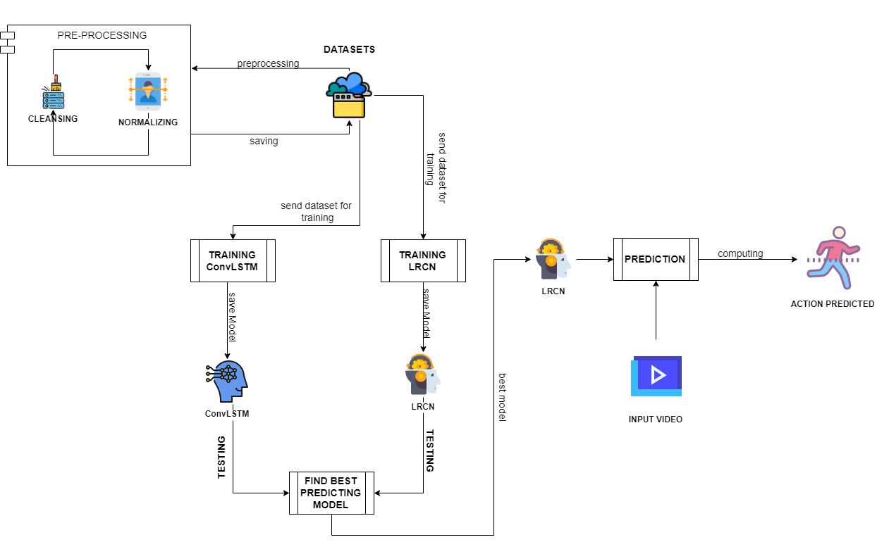

SYSTEM ARCHITECTURE

Slide 11
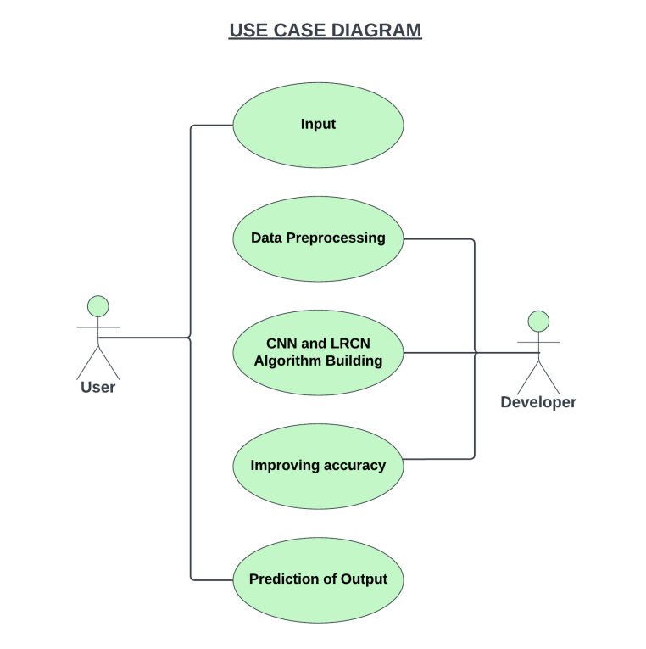
USE CASE DIAGRAM

Slide 12
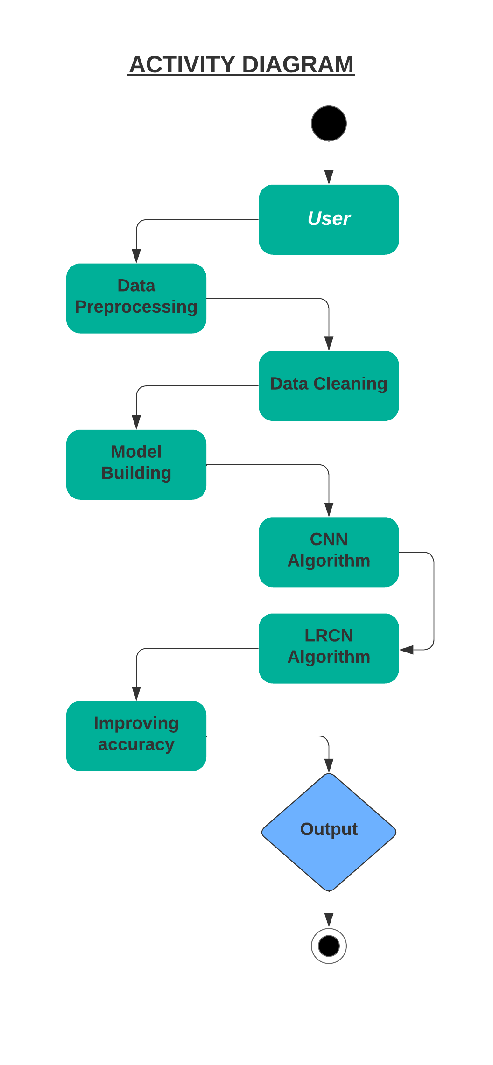
ACTIVITY DIAGRAM

Slide 13
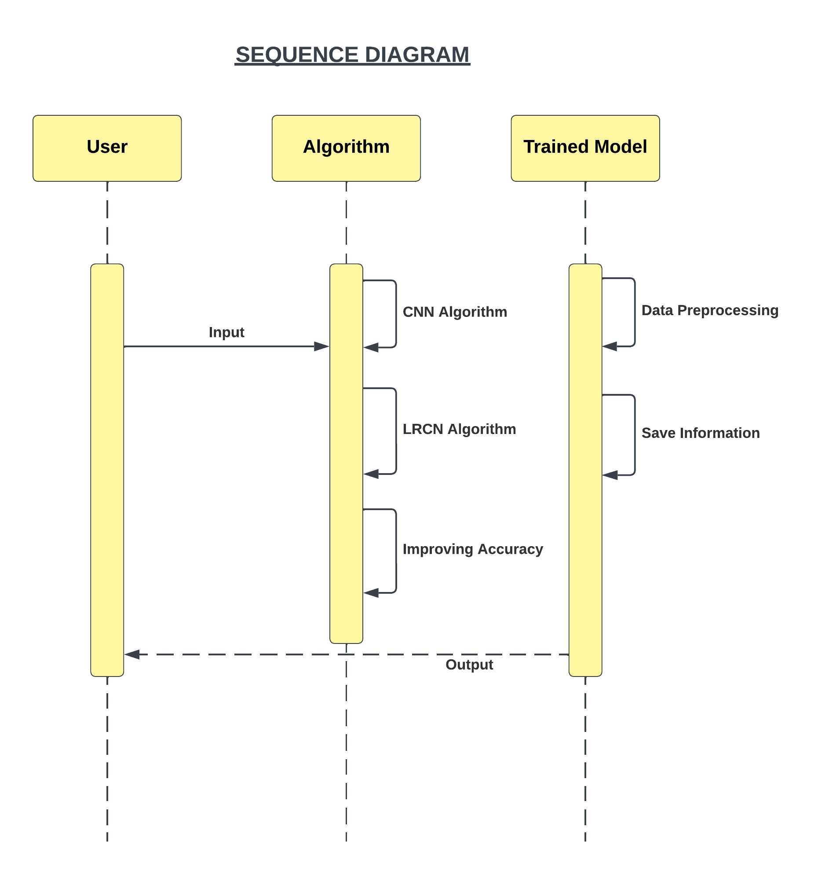
SEQUENCE DIAGRAM

Slide 14
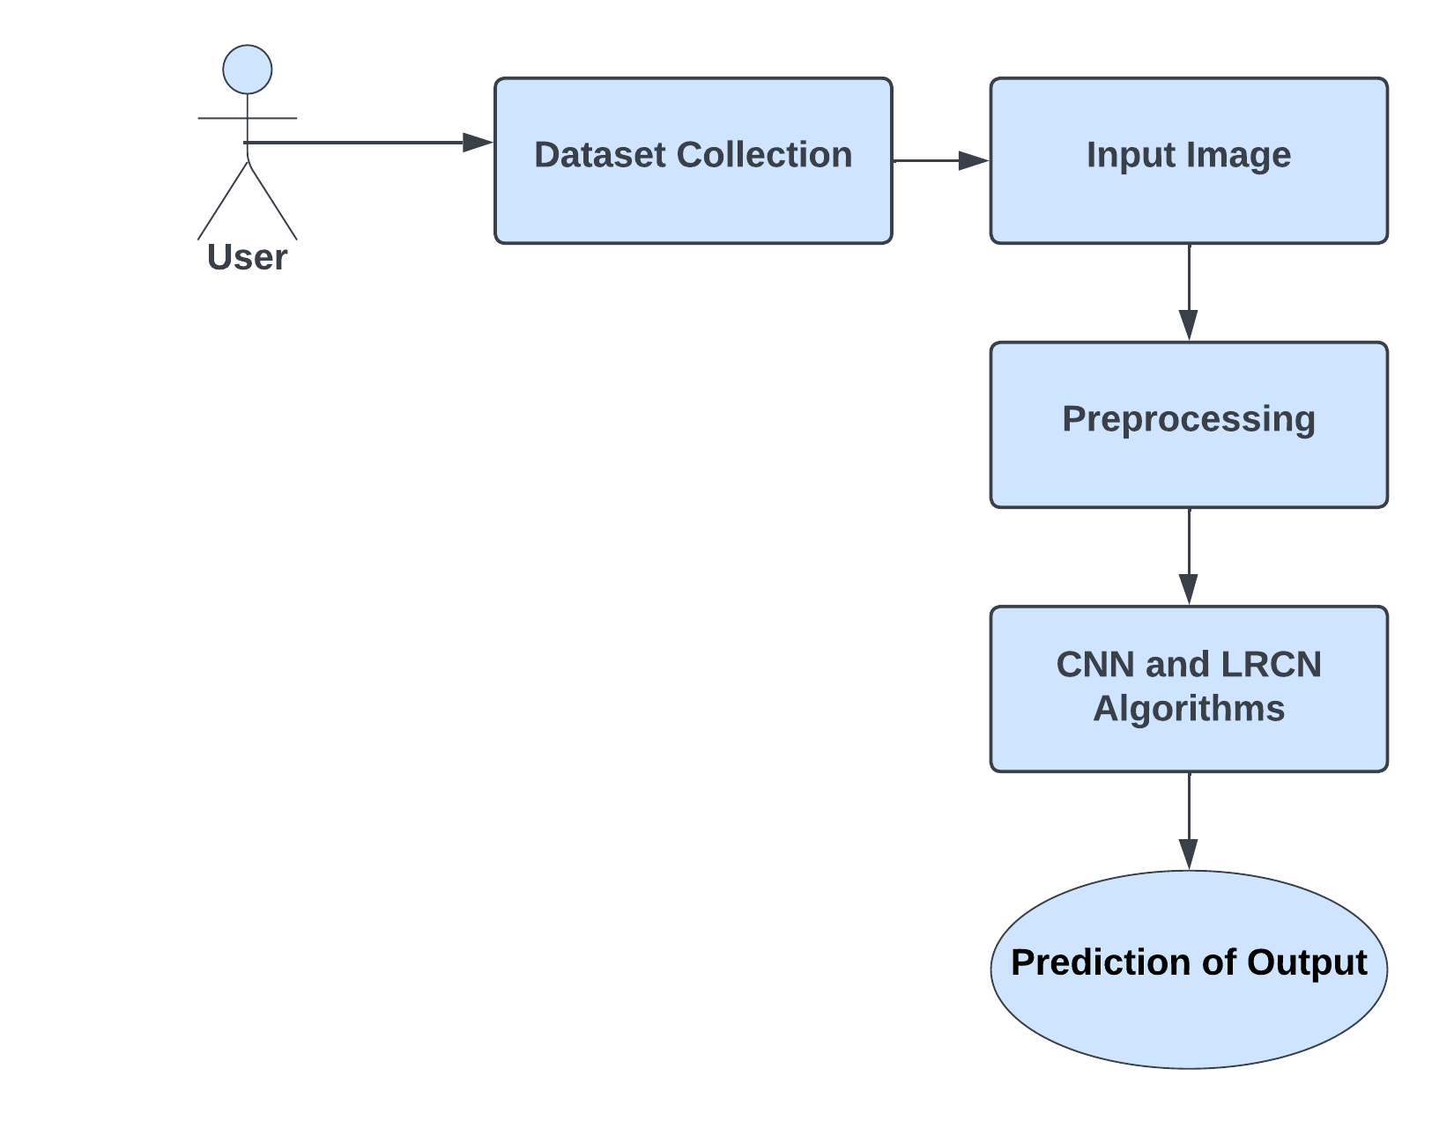
DFD DIAGRAM

Slide 15
Module Description - ConvLSTM
A combination of ConvLSTM cells is used to implement the first strategy in this stage. It is an LSTM with convolution included into the architecture, allowing it to recognize spatial characteristics of input while taking into consideration temporal relationships.
This method efficiently captures the spatial relationship between individual frames as well as the temporal relationship between distinct frames when it comes to video classification.
The ConvLSTM can take in 3-dimensional input (width, height, num of channels) as a result of this convolution structure, whereas a standard LSTM can only take in 1-dimensional input, making it unsuitable for modelling Spatio-temporal data on its own.

Slide 16
Module Description - LRCN
In this stage, the proposed system combines Convolution and LSTM layers in a single model to apply the LRCN Approach.
The Convolutional layers are utilized to extract spatial characteristics from the frames.
the retrieved spatial features are given to the LSTM layer(s) for temporal sequence modelling at each time-step.
A Time Distributed wrapper layer will also be employed, which allows us to apply the same layer to each frame of the movie separately.
As a result, if the layer's input shape was (width, height, num of channels), it may now take input of shape (no of frames, width, height, num of channels), which is highly useful because it allows you to input the entire movie into the model in a single shot.

Slide 17
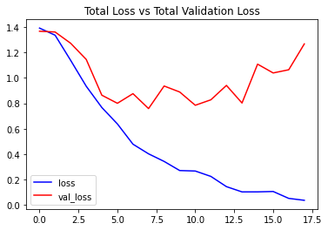
Total Loss Vs Validation Loss For CNN
In this model the validation loss curve came down with total loss and hence the model was stable and working fine.
When both the curves looks similar without any deviation the model with good accuracy and the model is trained well.

Slide 18
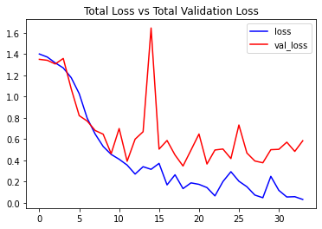
Total Loss Vs Validation Loss For LRCN
In this model the validation loss curve came down with total loss and hence the model was stable and working fine.
When both the curves looks similar without any deviation the model with good accuracy and the model is trained well.

Slide 19
Development Environment
HARDWARE REQUIREMENTS
Processor : Core i3 8th Gen – 3.0 Ghz
Hard disk : 15 GB
RAM : 4 GB (minimum)
Keyboard : 110 keys enhanced
SOFTWARE REQUIREMENTS
Operating system : Windows 10/11
IDE : Anaconda / Google Colab
Language : Python

Slide 20
Testing
Test Case No. | Action | Expected Output | Actual Output | Result (Pass/Fail)
TC_ID_001 | Prediction on a Swinging video | Swing | Swing | Pass
TC_ID_002 | Prediction on a video of walking a dog | Walking with dog | Walking with dog | Pass
TC_ID_003 | Prediction on a Tai Chi video | Tai Chi | Tai Chi | Pass
TC_ID_004 | Prediction on a Soccer Juggling video | Soccer juggling | Soccer juggling | Pass
TC_ID_005 | Prediction on a Cycling video | Cycling | Swing | Fail

Slide 21
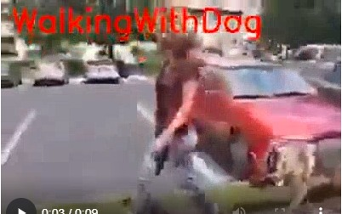
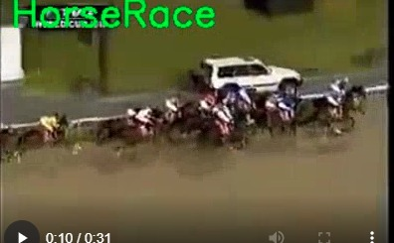
SCREENSHOTS
Action Predicted - Walking with dog
Action Predicted – Horse Race

Slide 22
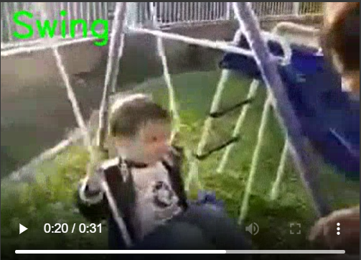
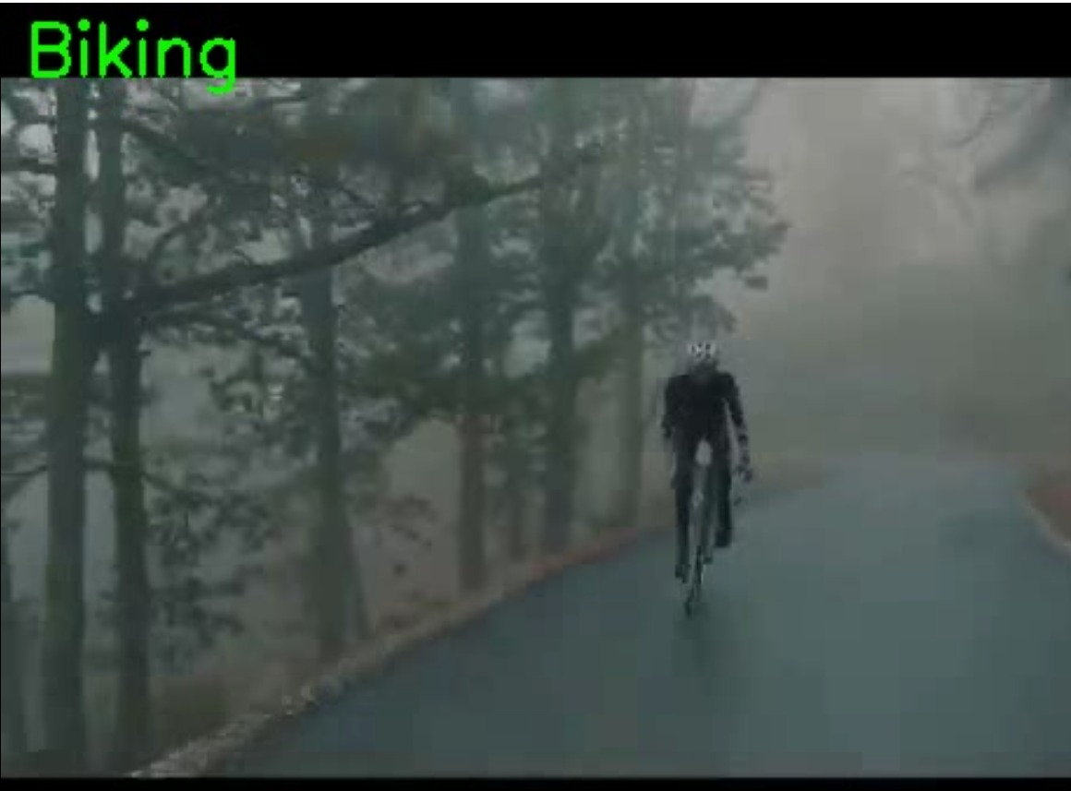
SCREENSHOTS
Action Predicted - Swing
Action Predicted – Biking

Slide 23
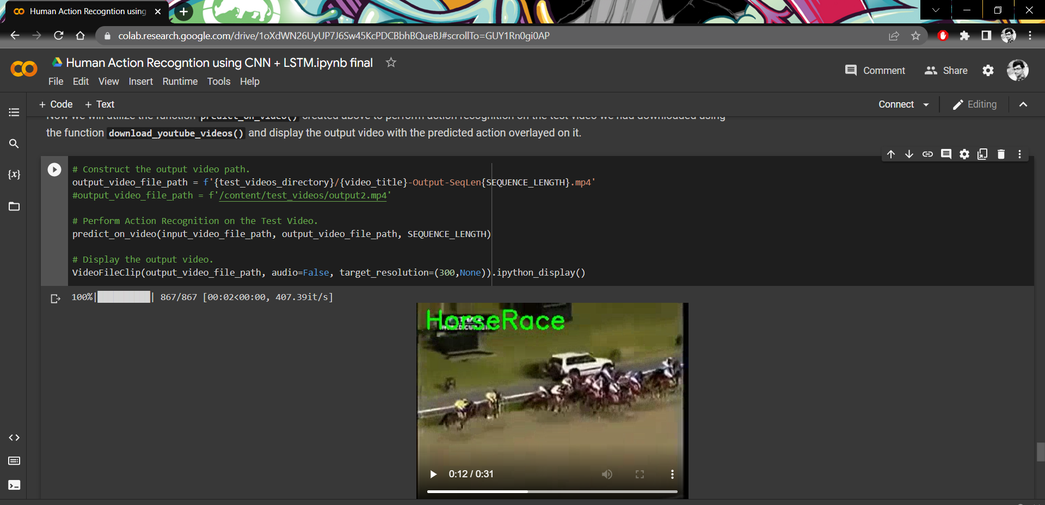
SCREENSHOTS

Slide 24
CONCLUSION
Following extensive testing, comparing results revealed that the model generates exact results with an accuracy of 90.90 percent, which is an important strategy for application in open contexts.
Because of its high Frame Per Second, this lightweight model is easy to assess and may be used constantly with the expansion of tiresome computation or picture collapsing.
Since this model can detect activities faster than other models, this system can be used for surveillance and supervision programs. If the GPU resources is improved, this model can be trained to improve its accuracy even more.

Slide 25
REFERENCE
Wenchao Xu; Yuxin Pang; Yanqin Yang; Yanbo Liu,” Human Activity Recognition Based On Convolutional Neural Network”, 2018 24th International Conference on Pattern Recognition (ICPR)
Gulustan Dogan; Sinem Sena Ertas; İremnaz Cay,” Human Activity Recognition Using Convolutional Neural Networks”,2021 IEEE CIBCB
Lamiyah Khattar; Chinmay Kapoor; Garima Aggarwal,” Analysis of Human Activity Recognition using Deep Learning”,Confluence
Abhay Gupta; Kuldeep Gupta; Kshama Gupta; Kapil Gupta, “A Survey on Human Activity Recognition and Classification”, 2020 IEEE ICCSP
Erhan Bulbul; Aydin Cetin; Ibrahim Alper Dogru,” Human Activity Recognition Using Smartphones”, 2018 IEEE ISMSIT

Slide 26
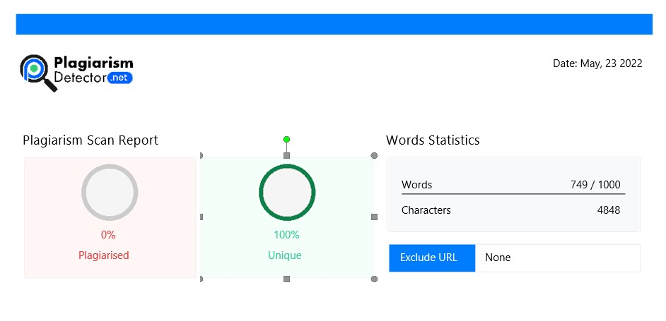
PLAGIARISM REPORT

